Slide 1
Phoenix: A Weight-Based
Network Coordinate System
Using Matrix Factorization
Yang Chen
Department of Computer Science
Duke University
ychen@cs.duke.edu

Slide 2
Outline
Background
System Design
Evaluation
Perspective Future Work

Slide 3
Background

Slide 4


Internet Distance
What?
Round-trip propagation / transmission delay between two Internet nodes
Why?
Strong indicator of network proximity
How?
Measurement tool “Ping” is with major operating systems
Relatively stable
50ms
Alice
Bob
Notes:
\

Slide 5
Use Cases
Knowledge of Internet distance is useful for…
  P2P content delivery (file sharing/streaming)
  Online/mobile games
  Overlay routing
  Server selection in P2P/Cloud
  Network monitoring

Slide 6

Scalability
Huge number of end-to-end paths in large scale systems
N nodes
measurements
SLOW and COSTLY when the system becomes large!

Slide 7
Network Coordinate (NC) Systems
(5, 10, 2)
(-3, 4, -2)
Alice
Bob
Distance Function
22ms
Scalable measurement: N² ➔ NK (K << N)
Every node is assigned with coordinates
Distance function: compute the distance between two nodes without explicit measurement
[Ng et al, INFOCOM’02]

Slide 8





Deployments
They are all using
Network Coordinate Systems!

Slide 9
Basic models
Euclidean Distance-based NC (ENC)
  Modeling the Internet as a Euclidean space
  Systems: Vivaldi [Dabek et al., SIGCOMM’04], GNP [Ng et al, INFOCOM’02], NPS [Ng et al., USENIX ATC’04], PIC [Costa et al., ICDCS’04]…
Matrix Factorization-based NC (MFNC)
  Factorizing an Internet distance matrix as the product of two smaller matrices
  Systems: IDES [Mao et al., JSAC’06], Phoenix, …

Slide 10
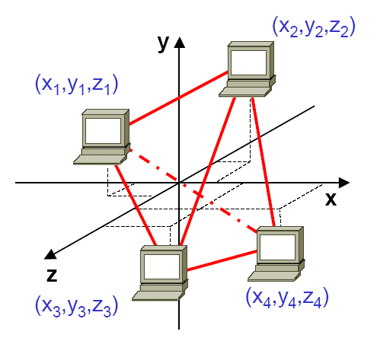
Modeling the Internet as a Euclidean space
d=3
In a d-dimensional Euclidean space, each node will be mapped to a position
Compute distances based on coordinates using Euclidean distance

Slide 11
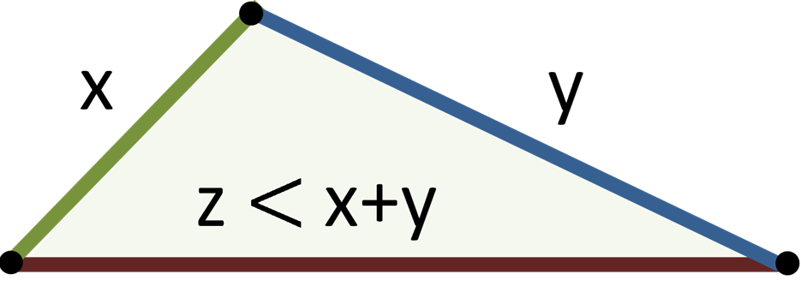
Triangle Inequality Violation
29.9 > 5.6+3.6
Czech Republic
5.6 ms
29.9 ms
Slovakia
3.6 ms
Hungary
Predicted distances in Euclidean space must satisfy triangle inequality
A Triangle Inequality Violation (TIV) example in GEANT network
Lots of TIVs in the Internet
due sub-optimal routing!!
[Zheng et al, PAM’05]

Slide 12






Correlation in Internet Distance Matrices
Distance measurement using PlanetLab nodes
 | Duke | UNC | Yale | Aachen | Oxford | Toronto | THU | NUS
Duke | - | 3 | 24 | 107 | 122 | 37 | 219 | 252
UNC | 3 | - | 24 | 106 | 109 | 38 | 219 | 253
Internet paths with nearby
end nodes are often overlap!!
Rows in different Internet distance matrices are large correlated (low effective rank)
[Tang et al, IMC’03], [Lim et al, ToN’05], [Liao et al, CoNEXT’11]

Slide 13
Factorization of an Internet Distance Matrix
N columns
d columns
N rows
[Mao et al., JSAC’06]

Slide 14
Matrix Factorization-Based NC
N columns
d columns
N rows
Each node i has an outgoing vector X_{i} and an incoming vector Y_{i}
Distance function is the dot product.
No triangle inequality constrain in this model!

Slide 15
SYSTEM DESIGN

Slide 16
Goals
Substantial improvement in prediction accuracy
Decentralized and scalable
Robust to dynamic Internet

Slide 17

Workflow of Phoenix
System Initialization
Peer Discovery
Scalable Measurement
Coordinates Calculation
System Initialization
Peer Discovery
Scalable Measurement
Coordinates Calculation

Slide 18
System Initialization
Measured Distance
Predicted Distance
(X₁,Y₁)
(X₂,Y₂)
(X₄,Y₄)
(X₃,Y₃)
Early nodes (N<K): Full-mesh measurement
Compute coordinates of early nodes by minimizing the overall discrepancy between predicted distances and measured distances
Nonnegative matrix factorization: [D. D. Lee and H. S. Seung, Nature, 401(6755):788–791, 1999.]

Slide 19



Dynamic Peer Discovery
Tracker
H₂ | H₃ | H₅
H₃ | H₄ | H₆
H₂ | H₃ | H₄ | H₅ | H₆
H₁ | H₃ | H₄ | H₅ | H₆
Gossip among nodes
N>K, all nodes become ordinary nodes

Slide 20
Reference Node Selection
Every new node randomly selects K existing nodes as reference nodes

Slide 21
Measurement and
Bootstrap Coordinates Calculation
Measured Distance
Predicted Distance
(X₂,Y₂)
(X_{K},Y_{K})
(X₁,Y₁)
(X_{new},Y_{new})
Node H_{new} computes its own coordinates by minimizing the overall discrepancy between predicted distances and measured distances (Non-negative least squares)

Slide 22


Accuracy of Reference Coordinates
(X_{A},Y_{A})
Node A
Distance between Node A and every other node

Slide 23


Accuracy of Reference Coordinates (cont.)
(X_{B},Y_{B})
Misleading the nodes referring to Node B!!
Node B
Distance between Node B and every other node

Slide 24


Referring to Inaccurate Coordinates
(X₂,Y₂)
(X_{K},Y_{K})
(X₁,Y₁)
Error Propagation: H_{new} may mislead nodes refer to it
(X_{new},Y_{new})
Give preference to
accurate reference coordinates
Minimize the impact of R_{K}

Slide 25

Heuristic Weight Assignment
Enhanced Coordinates
Bootstrap Coordinates
Updating coordinates regularly
Distance between H_{new} and every reference node

Slide 26
Evaluation

Slide 27
Evaluation Setup
Data sets
  PL: 169 PlanetLab nodes
  King: 1740 Internet DNS servers
Metric
  Relative Error (RE)

Slide 28
Evaluation: Relative Error
90th Percentile Relative Error
Phoenix | Phoenix (Simple) | Vivaldi | IDES
0.63 | 0.91 | 0.83 | 0.89

Slide 29
Evaluation (cont.)
Other findings through evaluation
  Robust to node churn
  Fast convergence
  Robust to measurement anomalies
  Robust to distance variation

Slide 30
Future work

Slide 31
Perspective Topics
NC systems in mobile-centric environment
  Access latency, host mobility, host churn
Scalable Prediction of other important network parameters
  Available bandwidth, shortest-path distance in social graph

Slide 32
Software
NCSim
  Simulator of Decentralized Network Coordinate Algorithms
  http://code.google.com/p/ncsim/
Phoenix
  Original Phoenix simulator in IEEE TNSM paper
  http://www.cs.duke.edu/~ychen/Phoenix_TNSM_2011.zip

