Slide 1


PacketCloud: an Open Platform for Elastic In-network Services
Yang Chen¹, Bingyang Liu², Yu Chen¹, Ang Li¹,
Xiaowei Yang¹, Jun Bi²
¹Duke University ²Tsinghua University
ychen@cs.duke.edu

Slide 2

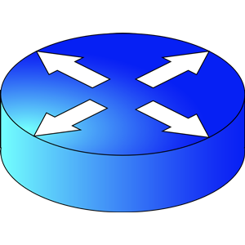
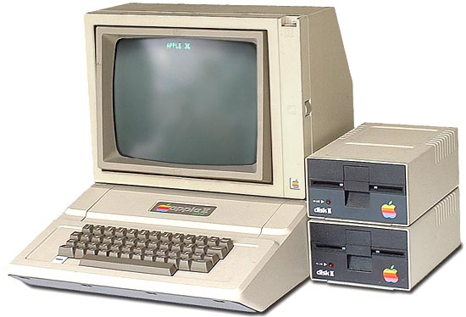
The End-to-End Principle of the Internet
Designed 30+ years ago
TCP
S
D
A simple design for IP routers:
low complexity, high robustness
TCP
Routers: best-effort forwarding
End systems: all end-to-end functions…
Background – Design – Evaluation – Contributions

Slide 3



The Ossification of the Internet
Popular contents are transferred again and again
Can we avoid the redundant transmission?
Numerous malicious attacks
Can we block the malicious traffic before they have arrived the destination?
Widely used mobile devices with limited battery energy
Can we offload the computational tasks for mobile devices?
In-network Services are highly desired
Background – Design – Evaluation – Contributions

Slide 4



In-network Services: Today’s Practice
ISPs have deployed numerous standalone, specialized middleboxes at strategic network locations
Third-party (content/application) providers need to collaborate with ISPs
Enhancing the user experience
Optimizing the network traffic
Fixed capacity for each middlebox (over provisioning)
The available resources of different middleboxes cannot be shared
Background – Design – Evaluation – Contributions

Slide 5





Our Goal: a Better
In-network Service Hosting Platform
Efficient
Elastic
Open
Rewards for ISPs
Design requirements
Background – Design – Evaluation – Contributions

Slide 6
Related Work
CoMb: consolidation of middleboxes [Sekar et al., NSDI’12]
  Supporting only trusted/reliable services
  Not open to third-party providers
  Vulnerable to unexpected service crash and malicious attacks
APLOMB: outsourcing to public clouds [Sherry et al., SIGCOMM’12]
  Unwanted interdomain traffic
  Data ownership problems
Background – Design – Evaluation – Contributions

Slide 7
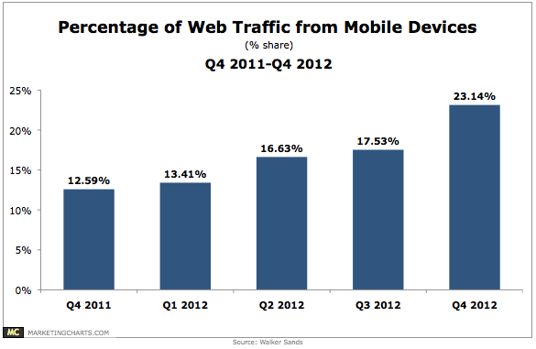
Underlying Network Architecture
  Conventional IP or clean-slate architectures?
  Technical trend: rapid development of mobile platforms and applications
We focus on MobilityFirst (MF)
A mobile-centric architecture for the future Internet, one of the four NSF Future Internet Architecture (FIA) projects
Background – Design – Evaluation – Contributions

Slide 8



MF: Prominent Features
A fixed globally unique identifier (GUID) for every network entity
  Robust to host mobility (keeping the end-to-end connection)
Optimized reliable data delivery
  Robust to data links with varying qualities (e.g., wireless links)
ISP X
ISP Y
GUID=20
GUID=10
ISP Z
3X Throughput of TCP
Background – Design – Evaluation – Contributions

Slide 9
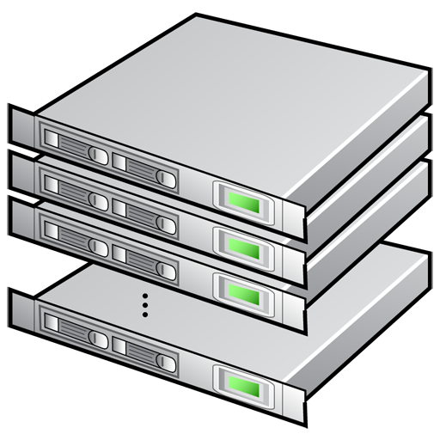
PacketCloud: Overview
New York
Washington
Cloudlet
Cloudlet
Cloudlets to support elastic in-network services
Background – Design – Evaluation – Contributions

Slide 10


Inside a Cloudlet
……
Serv 1
Cloudlet
Controller
Serv 2
DEMUX Rules
Resource Table (time slot: [t0, t1])
 | CPU (cores) | Mem (GB) | Disk (GB) | BW (Gbps)
N₁ | 7/1 | 1/1 | 250/50 | 5/5
N₂ | 4/4 | 0/2 | 50/200 | 9/1
… | … | … | … | …
Reserved / Available
Background – Design – Evaluation – Contributions

Slide 11
Virtualizing Computation Nodes
One computation node: multiple virtual instances (VIs)
Each service will be hosted by a dedicated VI
  Assigned with a globally routable GUID
  Programmable: supporting Linux-based general purpose services (extensible)
  Elastic resource allocation
3 cores
VI
VI
VI
1 core
Linux Containers (lxc)
Background – Design – Evaluation – Contributions

Slide 12


ISP-wide Resource Management
Cloudlet in LA
Cloudlet in DC
Cloudlet in NY
A logically centralized domain controller
Every cloudlet controller is one of its agents
Keeps an aggregate view of the resources of all cloudlets
Provides a web-based reservation interface for service providers
Background – Design – Evaluation – Contributions

Slide 13




Virtual Instance Reservation
Service identifier (SID):
Globally unique and routable
Upload the program
Least-loaded cloudlet
Oct 20, 2013
9AM-10AM
Time slot
VI type
Location (optional)
Small Instance:
2 cores, 1 GB Mem.
10GB Disk, 1Gbps BW
Background – Design – Evaluation – Contributions

Slide 14


User Requested Services
SID=30
Activated by
end users
s
D
S
D
SID=30
Payload
  Use Cases:
  Transcoder
  Protocol translator
  Context aware services
  Anonymous communications
Data delivery rule:
Source ➔ Selected service ➔ Destination
Background – Design – Evaluation – Contributions

Slide 15
Transparent Services
Service X
Activated by ISPs
Serving the legacy end-to-end traffic
Intercept!!!
S
D
S
D
Payload
DEMUX Rule:
a specified source/destination GUID
a specified field in the chunk header
……
Use Cases
Content caches
Wide Area Network (WAN) optimizers
On-path encryption/decryption systems
Intrucsion detection systems
Background – Design – Evaluation – Contributions

Slide 16




Reliability and Security
Service Failure
Inside the VI
Malicious Service
All in/out traffic can be inspected
Malicious DEMUX rule
Proof of GUID ownership required
Excessive resource usage
Reserving dedicated resources Tiered pricing
Background – Design – Evaluation – Contributions

Slide 17
A Proof-of-concept Prototype
Service-aware MF software router
  Based on the latest MF prototype (using Click Modular Router)
  Guiding the MF routers to identify and discover PacketCloud services
Implemented services
  Protocol translator (user requested)
  WAN optimizer (transparent)
  Intrusion detection system (transparent)
  Secure communication module (transparent)
  (more are coming…)
Background – Design – Evaluation – Contributions

Slide 18


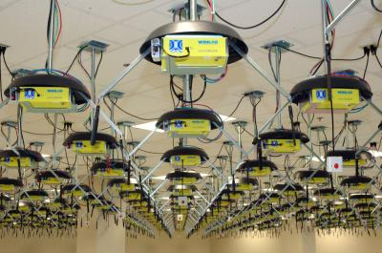
Test and Evaluation
Tested in both wired/wireless environments
Evaluation results
  Scalability
  Delay Penalty
Background – Design – Evaluation – Contributions

Slide 19
Scalability
How much traffic a cloudlet can handle?
  Starting from a single computation node…
  Hardware: bpc2133 nodes on Deterlab (Quad Core processor running at 2.13GHz, 1Gbps NIC)
  Service complexity: AES encryption (computationally intensive)
  One node can handle traffic as fast as 500~600Mbps
A modest estimation
20 nodes in a Cloudlet ➔ 10+Gbps
Background – Design – Evaluation – Contributions

Slide 20


Delay Penalty
Traffic Encryptor
A
100Mbps,30ms,0.1% Loss
R
100Mbps,30ms,0.1% Loss
B
When chunk size = 1MB, the average per-chunk delay penalty is still < 30ms (smaller than the additional delay of sending an individual IP packet using 3G)
Want a smaller delay penalty?
Better CPU
10Gbps NIC
Smaller protocol data unit
Background – Design – Evaluation – Contributions

Slide 21
Contributions
A “cloud-like” platform to host in-network services
  Elastic services: scaling up/down according to traffic demand
  Efficient resource sharing
  Open to third-party providers
  Viable economic rewards for ISPs
A number of viable use cases
A proof-of-concept prototype and evaluation
Background – Design – Evaluation – Contributions

Slide 22
Future Works
Cloudlet deployment strategy
  Network topology, user behavior, and resource availability
Economic Models
  Financial links among diﬀerent Internet entities, i.e., users, ISPs, and third-party providers
Background – Design – Evaluation – Contributions

Slide 23
Acknowledgements
Feixong Zhang, Kiran Nagaraja, and Dipankar Raychaudhuri (Rutgers University)
Qiang Cao, Xin Wu, Theophilus A. Benson (Duke University)

